Slide 1
Linear Regression Logistic Regression Support Vector Machine
Lei Qian, Ph.D.

Slide 2
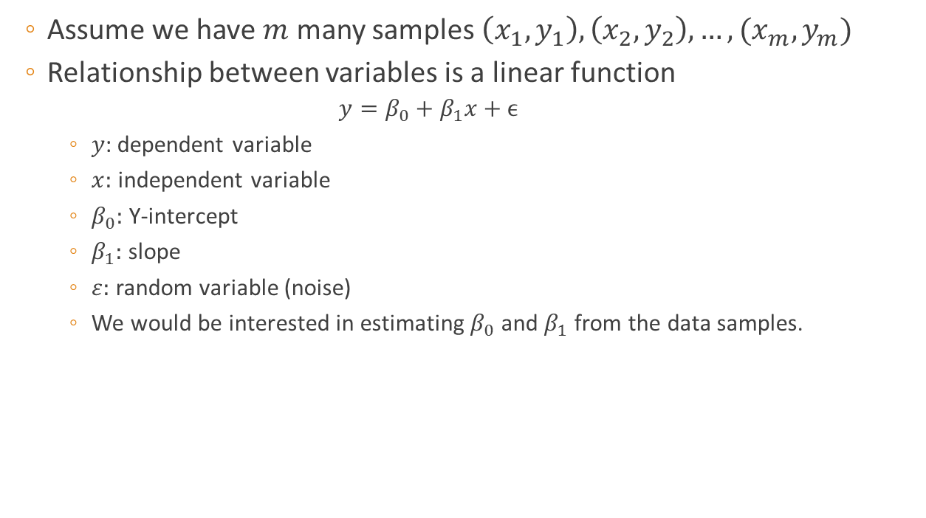
Simple Linear Regression
Assume we have $m$ many samples $\left(x_{1},y_{1}\right), \left(x_{2},y_{2}\right), …, (x_{m},y_{m})$
Relationship between variables is a linear function
$$y=β_{0}+β_{1}x+ϵ$$
$y$: dependent variable
$x:$ independent variable
$β_{0}:$ Y-intercept
$β_{1}:$ slope
$ε:$ random variable (noise)
We would be interested in estimating $β_{0}$ and $β_{1}$ from the data samples.

Slide 3




Simple Linear Regression
Meaning of $β_{0}$ and $β_{1}$
$β_{1}$ > 0 [positive slope] $β_{1}$ < 0 [negative slope]
y
$$y=β_{0}+β_{1}x+ε$$
rise
run
$β_{1}:$slope (=rise/run)
$$β_{0}$$
: y-intercept
x

Slide 4
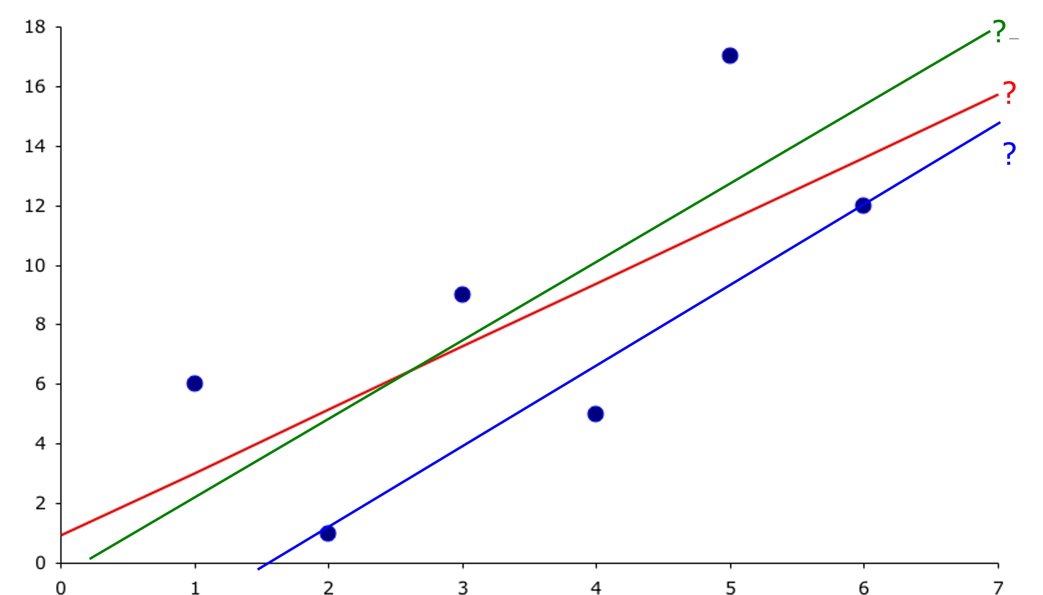
Which line has the best “fit” to the data?

Slide 5


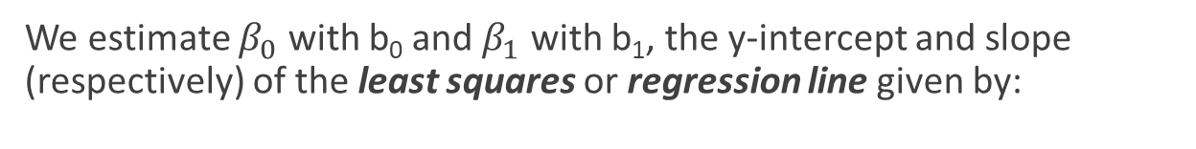
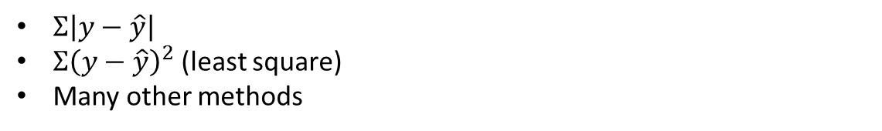
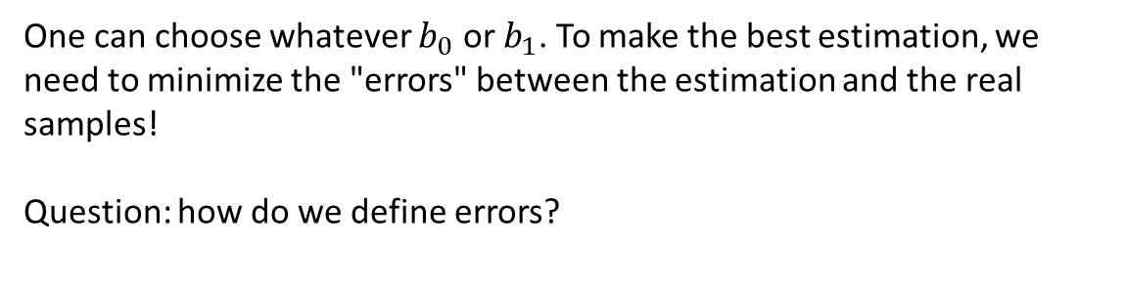
Estimating the Coefficients…
We estimate $β_{0}$ with b₀ and $β_{1}$ with b₁, the y-intercept and slope (respectively) of the least squares or regression line given by:
Prediction
Observation
$$\hat{y_{i}}=b_{0}+b_{1}x_{i}$$
$$y_{i}=β_{0}+β_{1}x_{i}$$
One can choose whatever $b_{0}$ or $b_{1}$. To make the best estimation, we need to minimize the "errors" between the estimation and the real samples!
Question: how do we define errors?
$Σ\left|y−\hat{y}\right|$
$Σ{\left(y−\hat{y}\right)}^{2}$ (least square)
Many other methods

Slide 6
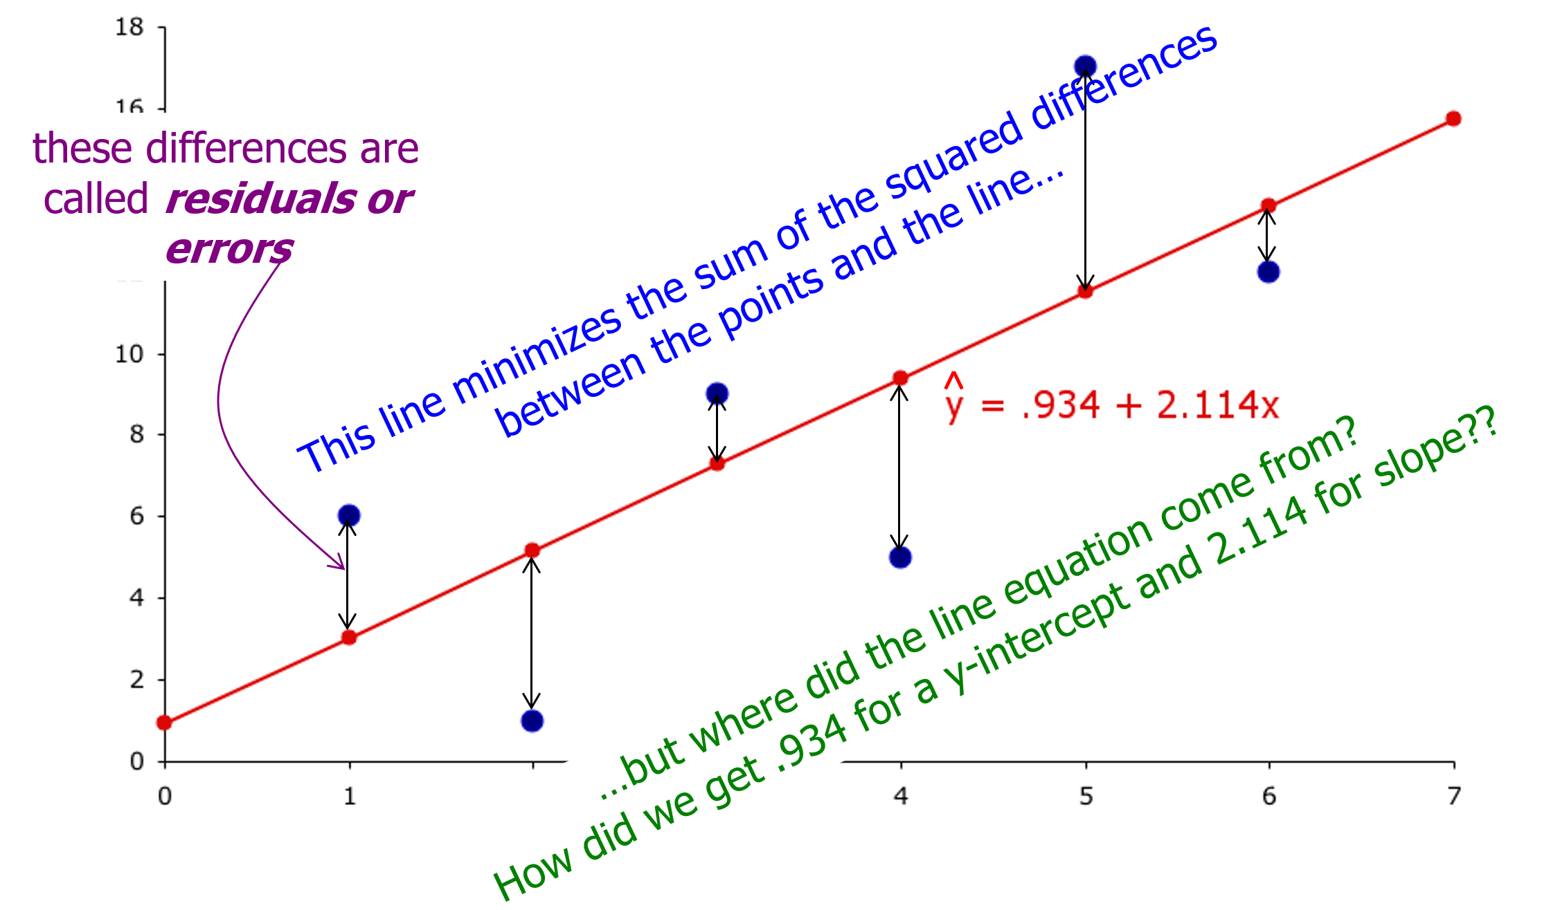
Least Squares Line

Slide 7

Simple Linear Regression
The coefficients b₁ and b₀ for the least squares line:
$$\hat{y}=b_{0}+b_{1}x$$
are calculated as:
$s_{xy}=\frac{Σ_{i=1}^{n}\left(x_{i}−\overline{x}\right)\left(y_{i}−\overline{y}\right)}{n}$ (Covariance)
$s_{x}^{2}=\frac{Σ_{i=1}^{n}{\left(x_{i}−\overline{x}\right)}^{2}}{n}$ (Variance)
$b_{1}=\frac{s_{xy}}{s_{x}^{2}}$ (Slope)
$b_{0}=\overline{y}−b_{1}\overline{x}$ (y-intercept)

Slide 8
Assessing the Model
The least squares method will always produce a straight line, even if there is no relationship between the variables, or if the relationship is something other than linear.
Hence, in addition to determining the coefficients of the least squares line, we need to assess it to see how well it “fits” the data. We’ll see these evaluation methods now. They’re based on the what is called sum of squares for errors (SSE).

Slide 9

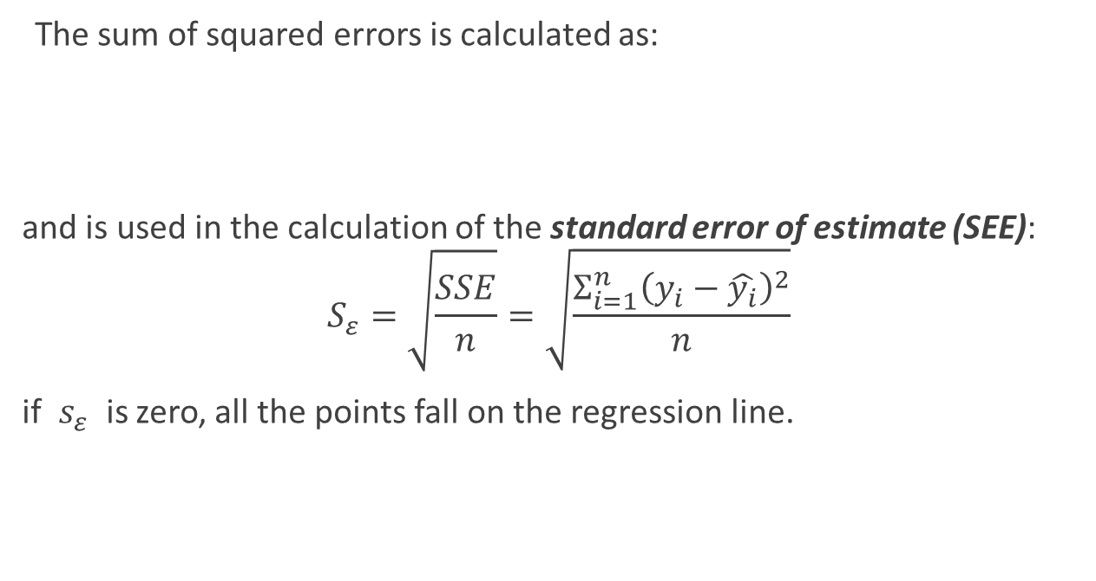
Sum of Squared Errors (SSE)
The sum of squared errors is calculated as:
and is used in the calculation of the standard error of estimate (SEE):
$$S_{ε}=\sqrt{\frac{SSE}{n}}=\sqrt{\frac{Σ_{i=1}^{n}{\left(y_{i}−\hat{y_{i}}\right)}^{2}}{n}}$$
if $s_{ε}$ is zero, all the points fall on the regression line.
$$SSE=n(S_{y}^{2}−\frac{S_{xy}^{2}}{S_{x}^{2}})$$

Slide 10
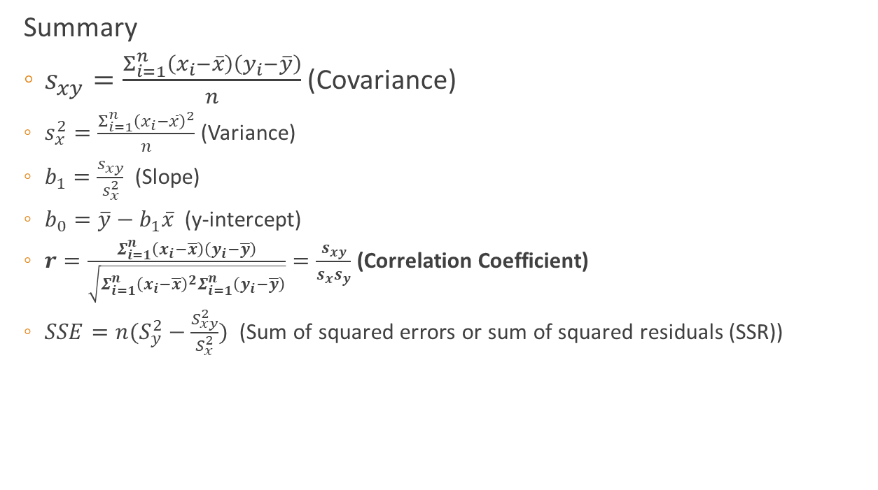
Linear Regression
Summary
$s_{xy}=\frac{Σ_{i=1}^{n}\left(x_{i}−\overline{x}\right)\left(y_{i}−\overline{y}\right)}{n}$ (Covariance)
$s_{x}^{2}=\frac{Σ_{i=1}^{n}{\left(x_{i}−\overline{x}\right)}^{2}}{n}$ (Variance)
$b_{1}=\frac{s_{xy}}{s_{x}^{2}}$ (Slope)
$b_{0}=\overline{y}−b_{1}\overline{x}$ (y-intercept)
$r=\frac{Σ_{i=1}^{n}\left(x_{i}−\overline{x}\right)\left(y_{i}−\overline{y}\right)}{\sqrt{Σ_{i=1}^{n}{\left(x_{i}−\overline{x}\right)}^{2}Σ_{i=1}^{n}\left(y_{i}−\overline{y}\right)}}=\frac{s_{xy}}{s_{x}s_{y}}$ (Correlation Coefficient)
$SSE=n(S_{y}^{2}−\frac{S_{xy}^{2}}{S_{x}^{2}})$ (Sum of squared errors or sum of squared residuals (SSR))

Slide 11
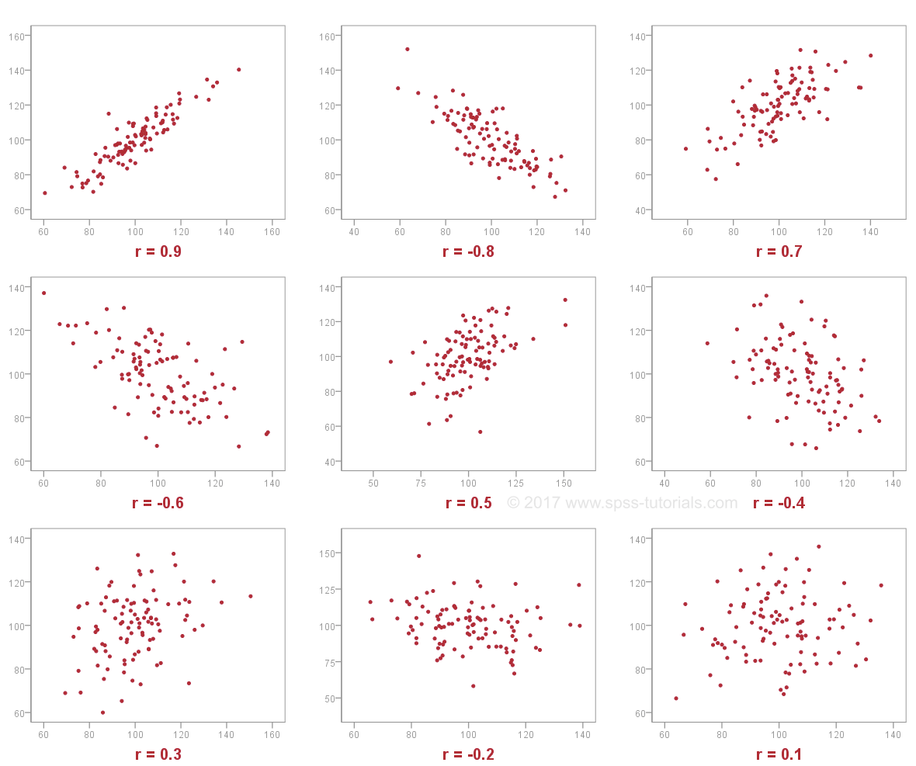
Correlation Coefficient

Slide 12

Multiple Linear Regression
Multiple linear regression models the relationship between two or more independent(explanatory) variables and a dependent(response) variable by fitting a linear equation to observed data.
Assume we have independent variables $x^{1},x^{2},…,x^{m}$ and a dependent variable $y$. The observations are $\left(x_{1}^{1},x_{1}^{2},…,x_{1}^{m}, y_{1}\right),…,(x_{n}^{1},x_{n}^{2},…,x_{n}^{m},y_{n})$. We assume the relationship is a multiple linear function:
$$y=b_{0}+b_{1}x^{1}+b_{2}x^{2}+…+b_{m}x^{m}$$
Therefore, the predictions are
${\hat{y}}_{i}=b_{0}+b_{1}x_{i}^{1}+b_{2}x_{i}^{2}+⋯+b_{m}x_{i}^{m}$ for $i=1,…,n$

Slide 13

Multiple Linear Regression
It would be much easier to represent independent variables in vector format. For convenient, we use the following conventions:
$x=[1, x^{1},⋯,x^{m}]$ , $x_{i}=\left[1, x_{i}^{1},⋯,x_{i}^{m}\right]$
For convenience, we can assume $x^{0}=1$.
We also represent parameters $b=\left[\begin{aligned}b_{0} \\ b_{1} \\ ⋮ \\ b_{m}\end{aligned}\right]$. Therefore, we have
$$y=xb$$
and
$$\hat{y_{i}}=x_{i}b$$
The format is almost identical to that of one-variable linear regression!

Slide 14

Multiple Linear Regression
Assume we have n many samples $\left(x_{1},y_{1}\right), \left(x_{2},y_{2}\right),…,\left(x_{n},y_{n}\right)$, we can write observations of all independent variables as an $n×\left(m+1\right)$ matrix:
$$X=\left[\begin{matrix}1 & x_{1}^{1} & ⋯ & x_{1}^{m} \\ 1 & x_{2}^{1} & ⋯ & x_{2}^{m} \\ ⋮ & ⋮ & ⋱ & ⋮ \\ 1 & x_{n}^{1} & ⋯ & x_{n}^{m}\end{matrix}\right]=\left[\begin{matrix}x_{1} \\ x_{2} \\ ⋮ \\ x_{n}\end{matrix}\right]$$
Where each columns is the observations of a sample. Assume $b={\left[b_{0},⋯,b_{m}\right]}^{T}$, we have:
$$\hat{Y}=\left[\begin{matrix}{\hat{y}}_{1} \\ {\hat{y}}_{2} \\ ⋮ \\ {\hat{y}}_{n}\end{matrix}\right]=\left[\begin{matrix}1 & x_{1}^{1} & ⋯ & x_{1}^{m} \\ 1 & x_{2}^{1} & ⋯ & x_{2}^{m} \\ ⋮ & ⋮ & ⋱ & ⋮ \\ 1 & x_{n}^{1} & ⋯ & x_{n}^{m}\end{matrix}\right]\left[\begin{matrix}b_{0} \\ b_{1} \\ ⋮ \\ b_{m}\end{matrix}\right]=Xb$$

Slide 15

Multiple Linear Regression
We have $y_{i}=\hat{y_{i}}+ε_{i}=x_{i}b+ε_{i}$ where $ε_{i}$ is the residual. The goal is to minimize ${\left(y_{i}−\hat{y_{i}}\right)}^{2}$
All concepts in single variable linear regression can be adopted to multiple variable linear regression:
Sum of Squared Errors: $SSE=Σ_{i=1}^{n}ε_{i}^{2}=Σ_{i=1}^{n}{\left(\hat{y_{i}}−y_{i}\right)}^{2}$
Sum of Squared Total: $SST=Σ_{i=1}^{n}{\left(y_{i}−\overline{y}\right)}^{2}$
Sum of Squares due to regression: $SSR=Σ_{i=1}^{n}{\left(\hat{y_{i}}−\overline{y}\right)}^{2}=SST−SSE$
Correlation coefficient r: $r^{2}=\frac{SSR}{SST}=1−\frac{SSE}{SST}$
All these quantities are related to dependent variable and are single numbers, not vectors (arrays).
Note that r is always non-negative for multiple linear regression!

Slide 16

Multiple Linear Regression
The solution is:
$$b={\left(X^{T}X\right)}^{−1}X^{T}Y$$
Where $X^{T}$ is the transpose of $X$.
$$X^{\text{†}}{=\left(X^{T}X\right)}^{−1}X^{T}$$
is also called pseudo-inverse. Therefore we can write
$$b=X^{\text{†}}Y$$
$$\hat{Y}=Xb={X\left(X^{T}X\right)}^{−1}X^{T}Y$$

Slide 17

Multiple Linear Regression
Given $X and Y$,
$$b={\left(X^{T}X\right)}^{−1}X^{T}Y$$
$$\hat{Y}=Xb={X\left(X^{T}X\right)}^{−1}X^{T}Y$$
$$E=Y−\hat{Y}=Y−HY=\left(I−H\right)Y$$
$$SSE=E^{T}E=Y^{T}{\left(I−H\right)}^{T}\left(I−H\right)Y=Y^{T}\left(I−H\right)Y$$
$$SST={\left(Y−\overline{Y}\right)}^{T}\left(Y−\overline{Y}\right)$$
$$r^{2}=\frac{SSR}{SST}=1−\frac{SSE}{SST}$$
Note that for multiple linear regression, r is always non-negative.

Slide 18
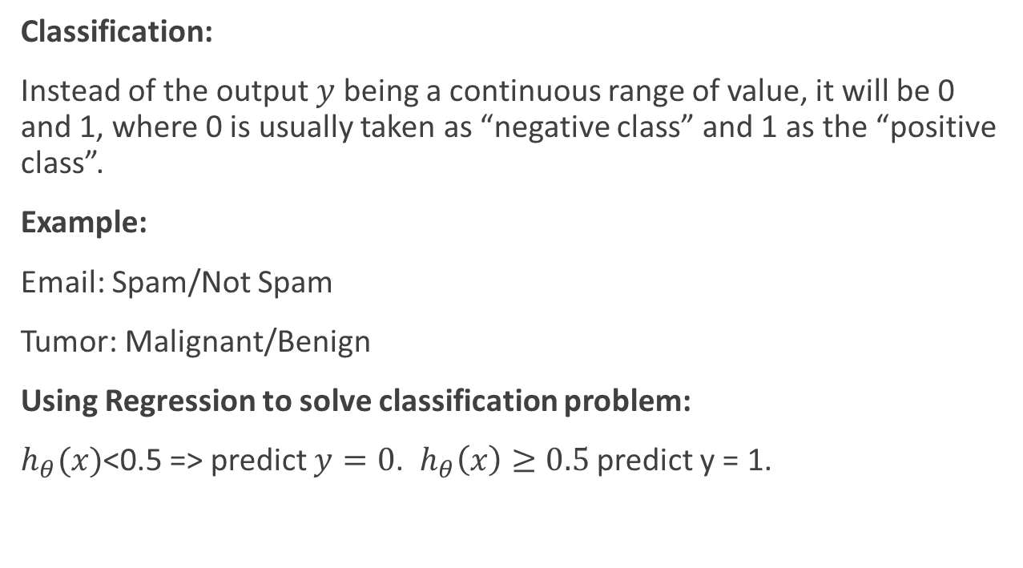
Classification Problems
Classification:
Instead of the output $y$ being a continuous range of value, it will be 0 and 1, where 0 is usually taken as “negative class” and 1 as the “positive class”.
Example:
Email: Spam/Not Spam
Tumor: Malignant/Benign
Using Regression to solve classification problem:
$h_{θ}(x)$<0.5 => predict $y=0$. $h_{θ}\left(x\right)≥0.5$ predict y = 1.

Slide 19
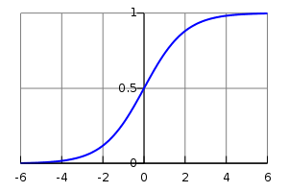
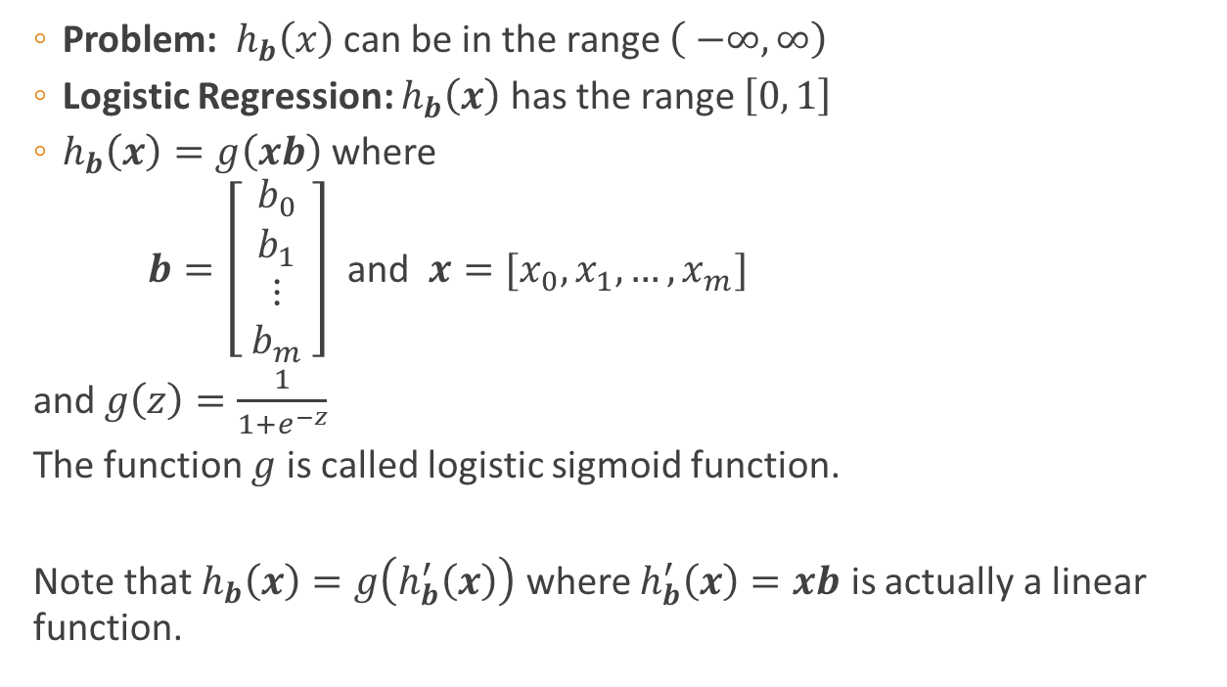

Logistic Regression
Problem: $h_{b}\left(x\right)$ can be in the range $\left( −∞, ∞\right)$
Logistic Regression: $h_{b}\left(x\right)$ has the range $\left[0, 1\right]$
$h_{b}\left(x\right)=g\left(xb\right)$ where
$b=\left[\begin{matrix}b_{0} \\ b_{1} \\ ⋮ \\ b_{m} \end{matrix}\right]$ and $x=[x_{0},x_{1},…,x_{m}]$
and $g\left(z\right)=\frac{1}{1+e^{−z}}$
The function $g$ is called logistic sigmoid function.
Note that $h_{b}\left(x\right)=g\left(h_{b}^{′}\left(x\right)\right)$ where $h_{b}^{′}\left(x\right)=xb$ is actually a linear function.
$$y=g(x)$$

Slide 20

Logistic Regression
$g\left(z\right)=\frac{1}{1+e^{−z}}$ is called logistic or sigmoid function.
Exercise: prove that
$\frac{dg}{dz}=g(z)(1−g\left(z\right))$
$g\left(−z\right)=1−g(z)$
Thus $x→f\left(x\right)−\frac{1}{2}$ is an odd function
$$y=g(x)$$

Slide 21
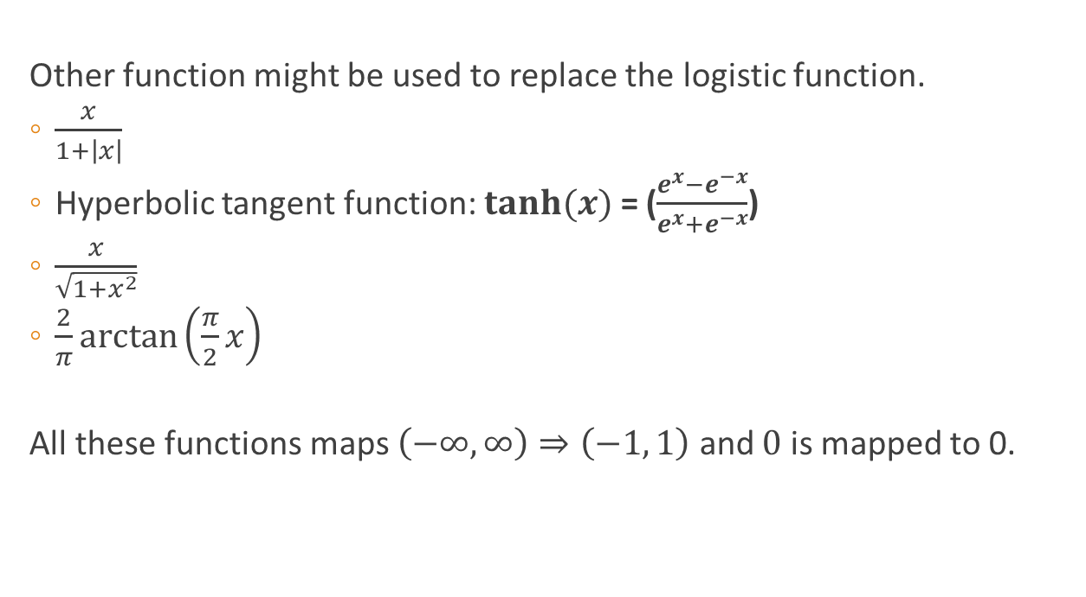
Logistic Regression
Other function might be used to replace the logistic function.
$\frac{x}{1+\left|x\right|}$
Hyperbolic tangent function: $tanh⁡(x)$ = ($\frac{e^{x}−e^{−x}}{e^{x}+e^{−x}}$)
$\frac{x}{\sqrt{1+x^{2}}}$
$\frac{2}{π}\arctan\left(\frac{π}{2}x\right)$
All these functions maps $\left(−∞,∞\right)⇒\left(−1, 1\right)$ and $0$ is mapped to 0.

Slide 22
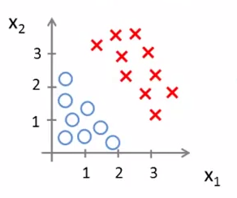
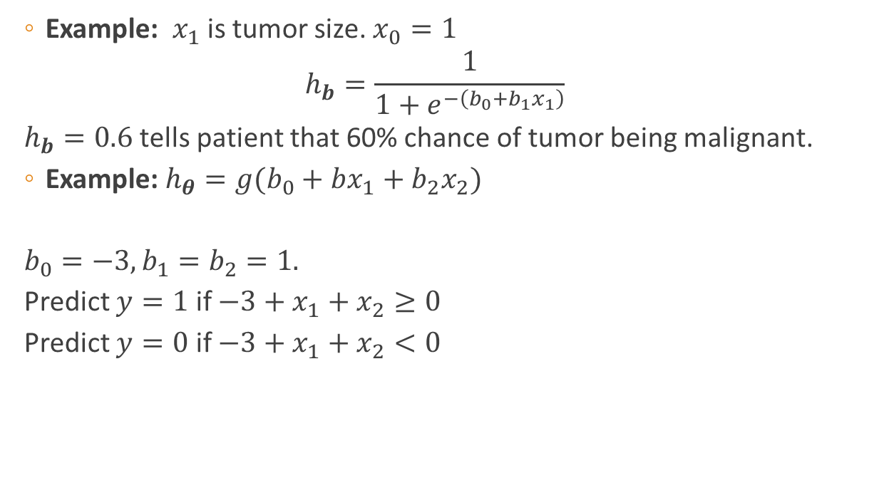
Logistic Regression
Example: $x_{1}$ is tumor size. $x_{0}=1$
$$h_{b}=\frac{1}{1+e^{−\left(b_{0}+b_{1}x_{1}\right)}}$$
$h_{b}=0.6$ tells patient that 60% chance of tumor being malignant.
Example: $h_{θ}=g(b_{0}+bx_{1}+b_{2}x_{2})$
$b_{0}=−3, b_{1}=b_{2}=1.$
Predict $y=1$ if $−3+x_{1}+x_{2}≥0$
Predict $y=0$ if $−3+x_{1}+x_{2}<0$

Slide 23
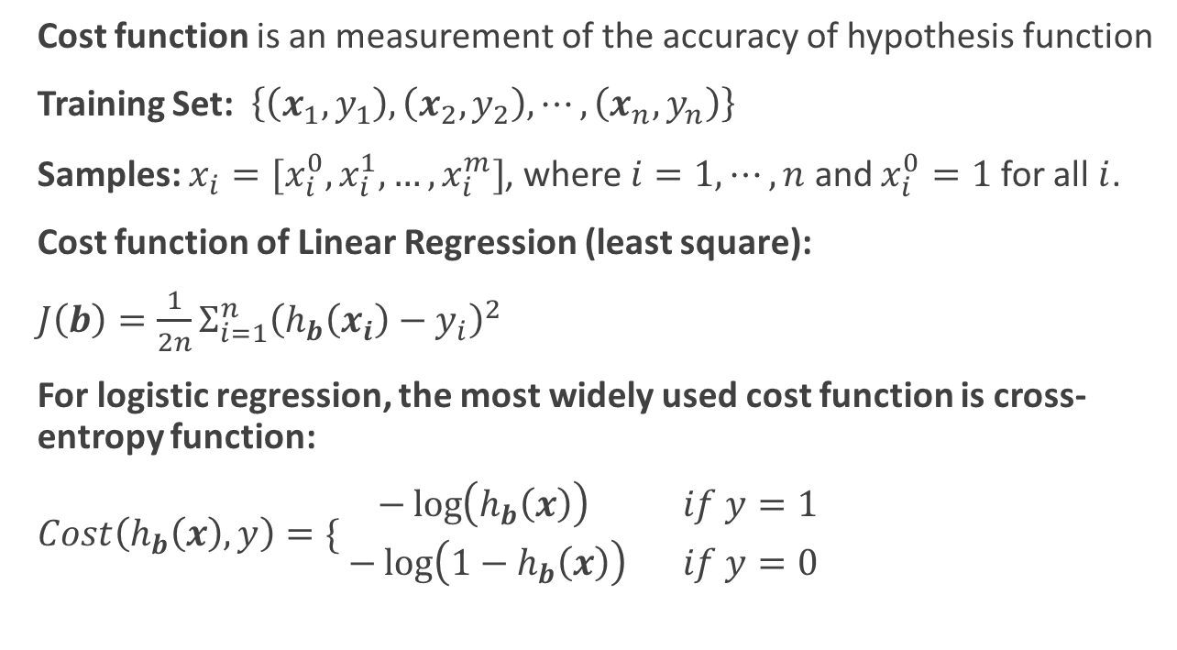
Cost Function
Cost function is an measurement of the accuracy of hypothesis function
Training Set: $\left\{\left(x_{1},y_{1}\right), \left(x_{2}, y_{2}\right),⋯,\left(x_{n},y_{n}\right)\right\}$
Samples: $x_{i}=[x_{i}^{0},x_{i}^{1},…,x_{i}^{m}]$, where $i=1,⋯,n$ and $x_{i}^{0}=1$ for all $i$.
Cost function of Linear Regression (least square):
$J\left(b\right)=\frac{1}{2n}Σ_{i=1}^{n}{\left(h_{b}\left(x_{i}\right)−y_{i}\right)}^{2}$
For logistic regression, the most widely used cost function is cross-entropy function:
$Cost\left(h_{b}\left(x\right), y\right)=\{\begin{matrix}−\log\left(h_{b}\left(x\right)\right) & if y=1 \\ −\log\left(1−h_{b}\left(x\right)\right) & if y=0 \end{matrix}$

Slide 24
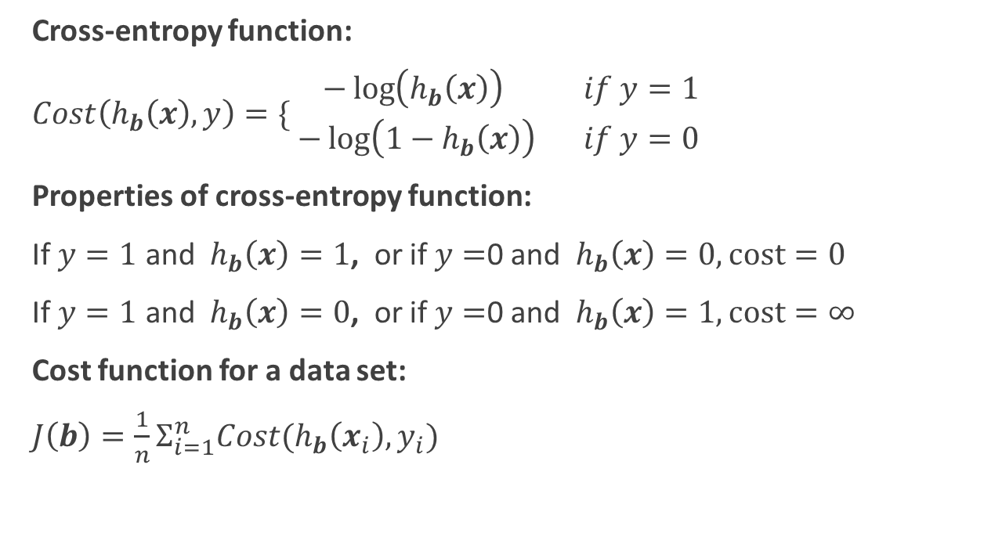
Cost Function
Cross-entropy function:
$Cost\left(h_{b}\left(x\right), y\right)=\{\begin{matrix}−\log\left(h_{b}\left(x\right)\right) & if y=1 \\ −\log\left(1−h_{b}\left(x\right)\right) & if y=0 \end{matrix}$
Properties of cross-entropy function:
If $y=1$ and $h_{b}\left(x\right)=1$, or if $y=$0 and $h_{b}\left(x\right)=0, cost=0$
If $y=1$ and $h_{b}\left(x\right)=0$, or if $y=$0 and $h_{b}\left(x\right)=1, cost=∞$
Cost function for a data set:
$J\left(b\right)=\frac{1}{n}Σ_{i=1}^{n}Cost(h_{b}\left(x_{i}\right), y_{i})$

Slide 25
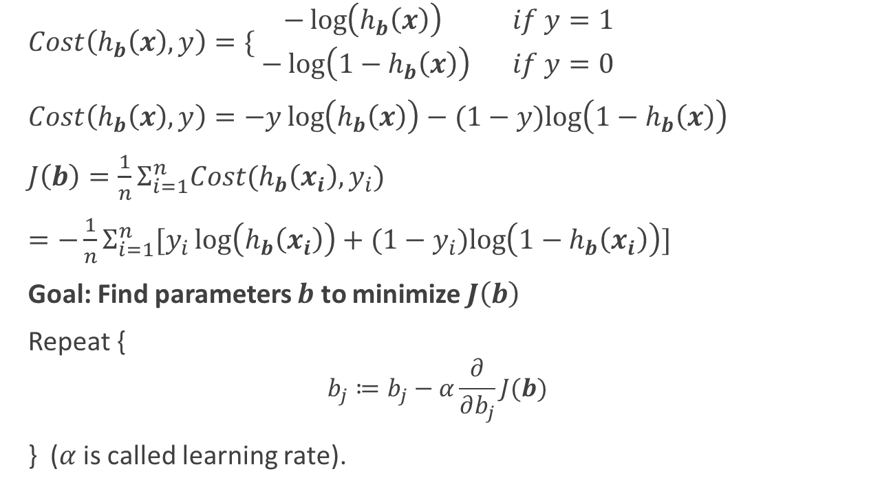
Gradient Decent
$Cost\left(h_{b}\left(x\right), y\right)=\{\begin{matrix}−\log\left(h_{b}\left(x\right)\right) & if y=1 \\ −\log\left(1−h_{b}\left(x\right)\right) & if y=0 \end{matrix}$
$Cost\left(h_{b}\left(x\right), y\right)=−y\log\left(h_{b}\left(x\right)\right)−(1−y)log\left(1−h_{b}\left(x\right)\right)$
$J\left(b\right)=\frac{1}{n}Σ_{i=1}^{n}Cost(h_{b}\left(x_{i}\right), y_{i})$
$=−\frac{1}{n}Σ_{i=1}^{n}[y_{i}\log\left(h_{b}\left(x_{i}\right)\right)+(1−y_{i})log\left(1−h_{b}\left(x_{i}\right)\right)]$
Goal: Find parameters $b$ to minimize $J\left(b\right)$
Repeat {
$$b_{j}≔b_{j}−α\frac{∂}{∂b_{j}}J(b)$$
} ($α$ is called learning rate).

Slide 26
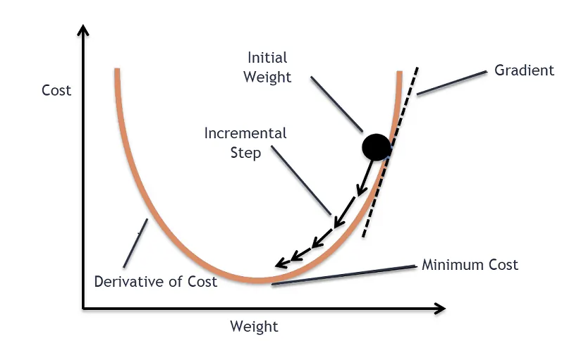
Gradient Decent

Slide 27
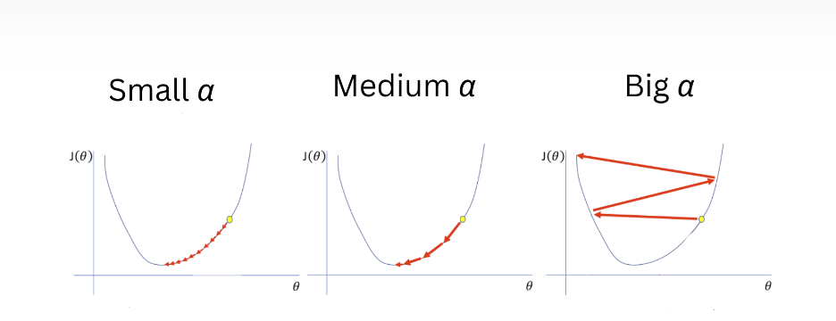
Choose the correct Learning Rate

Slide 28
Logistic Regression for multiple classes
Logistic Regression is a binary classifier. The native model can only be used to two-class problems.
Binary classifiers can be used to solve multiple-class problems by various methods. They can be:
One-vs-Rest (OVR): this strategy involves training a single classifier per class, with the samples of that class as positive samples and all other samples as negatives.
One-vs-One (OVO): this strategy involves training K (K − 1) / 2 binary classifiers for a K-way multiclass problem.
Multinomial: this strategy use softmax function to replace sigmoid function as the activation function and calculates probabilities of all classes at one time.

Slide 29
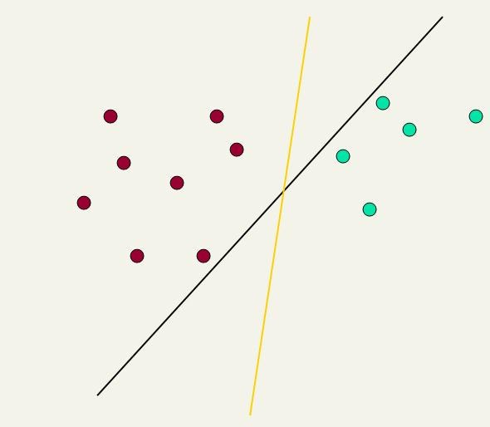
Linear classifiers: Which Hyperplane?
Ch. 15
This line represents the decision boundary:
ax + by − c = 0
Lots of possible solutions for a, b, c.
Some methods find a separating hyperplane, but not the optimal one
E.g., perceptron
Support Vector Machine (SVM) finds an optimal solution.
Maximizes the distance between the hyperplane and the “difficult points” close to decision boundary
One intuition: if there are no points near the decision surface, then there are no very uncertain classification decisions
Notes:
But note that Naïve Bayes also finds an optimal solution … just under a different definition of optimality.

Slide 30
Another intuition
Sec. 15.1
If you have to place a fat separator between classes, you have less choices, and so the capacity of the model has been decreased

Slide 31
Support Vector Machine (SVM)
Sec. 15.1
Support vectors
SVMs maximize the margin around the separating hyperplane.
A.k.a. large margin classifiers
The decision function is fully specified by a subset of training samples, the support vectors.
Solving SVMs is a quadratic programming problem
Maximizes
margin
Narrower
margin

Slide 32





Geometric Margin
Sec. 15.1
Distance from an example (x,y) to the separator is $r=\frac{y\left(xw+b\right)}{|w|}$
Examples closest to the hyperplane are support vectors.
Margin ρ of the separator is the width of separation between support vectors of classes.
$$x$$
ρ
$$r$$
$$x′$$
$$w$$
Notes:
Looking for distance r. Dotted line x’-x is perpendicular to decision boundary so parallel to w. Unit vector is w/|w|, so this one is rw/|w|.
x’ = x – rw/|w|. X’ satisfies wx+b = 0.
So wT(x –rw/|w|) + b = 0
Recall that |w| = sqrt(wTw). So, solving for r gives:
r = y(wTx + b)/|w|

Slide 33
Soft Margin Classification
Sec. 15.2.1
If the training data is not linearly separable, slack variables ξ_{i} can be added to allow misclassification of difficult or noisy examples.
Allow some errors (also consider as avoiding overfitting)
Let some points be moved to where they belong, at a cost
Still, try to minimize training set errors, and to place hyperplane “far” from each class (large margin)
ξ_{i}
ξ_{j}

Slide 34
Non-linear SVMs
Sec. 15.2.3
Datasets that are linearly separable (with some noise) work out great:
But what are we going to do if the dataset is just too hard?
How about … mapping data to a higher-dimensional space:
0
x
0
x
x²
0
x

Slide 35
Non-linear SVMs: Feature spaces
Sec. 15.2.3
General idea: the original feature space can always be mapped to some higher-dimensional feature space where the training set is separable:
Φ: x → φ(x)

Slide 36
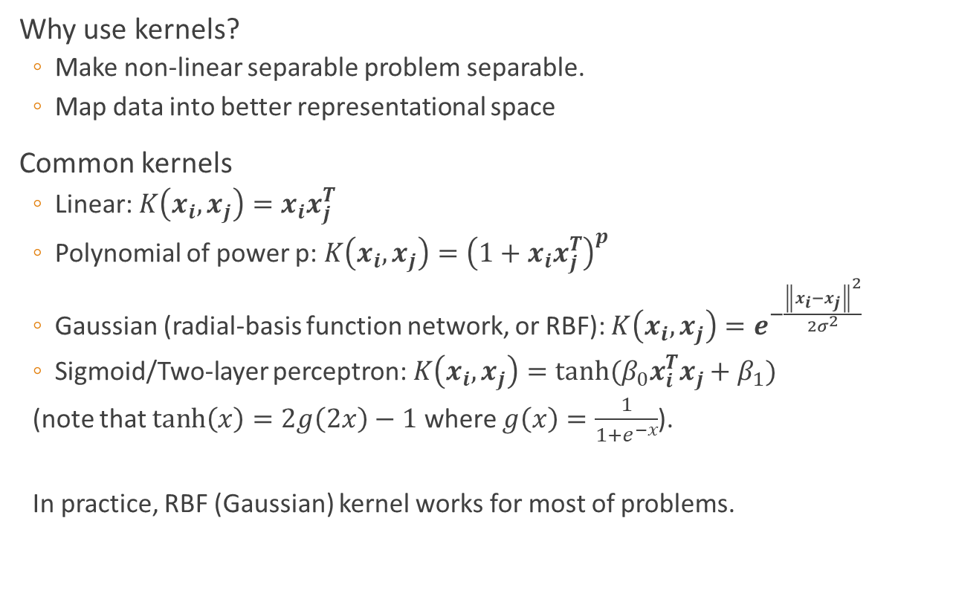
Kernels
Sec. 15.2.3
Why use kernels?
Make non-linear separable problem separable.
Map data into better representational space
Common kernels
Linear: $K\left(x_{i},x_{j}\right)=x_{i}x_{j}^{T}$
Polynomial of power p: $K\left(x_{i},x_{j}\right)={\left(1+{x_{i}x}_{j}^{T}\right)}^{p}$
Gaussian (radial-basis function network, or RBF): $K\left(x_{i},x_{j}\right)=e^{−\frac{{\left\|x_{i}−x_{j}\right\|}^{2}}{2σ^{2}}}$
Sigmoid/Two-layer perceptron: $K\left(x_{i},x_{j}\right)=tanh(β_{0}x_{i}^{T}x_{j}+β_{1})$
(note that $tanh\left(x\right)=2g\left(2x\right)−1$ where $g\left(x\right)=\frac{1}{1+e^{−x}}$).
In practice, RBF (Gaussian) kernel works for most of problems.

